Slide 1
Week 5 Lecture
Algorithms and Data Structures
      Dr Mehmet Bülent Özcan,
      (Module Leader/Lecturer/Tutor)
        Room: Cantor 9418
        Phone: extn 6900
        Email: m.b.ozcan@shu.ac.uk

Slide 2
Learning Objectives
To understand the priority queue data structure

Slide 3
Contents of the Lecture
Priority Queues
Representation of Priority Queues in Memory
Singly Linked List Representation
Array Representation
Space-Speed Trade-Off

Slide 4
Priority Queues
A priority queue is a collection of elements such that each element has been assigned a priority and such that the order in which elements are deleted and processed comes from the following rules:
  An element of higher priority is processed before any element of lower priority.
  Two elements with the same priority are processed according to the order in which they were added to the queue.
A prototype of a priority queue is a timesharing system: programs of high priority are processed first, and programs with the same priority form a standard queue.

Slide 5
Representation of Priority Queues in Memory
Priority Queues can be represented in four different ways in computer memory. These are:
  An array
  A singly linked list
  A heaped data structure
  A binary search tree
In this lecture, we will focus on (1) and (2).

Slide 6
Singly Linked List Representation
One way to maintain a priority queue in memory is by means of a singly linked list as discussed below:
  Each node in the list will contain three items of information: an information field INFO, a priority number PRN and a link number LINK.
  A node X precedes a node Y in the list (1) when X has a higher priority than Y or (2) when both have the same priority, but X was added to the list before Y. This means that the order in the singly linked list corresponds to the order of the priority queue.

Slide 7
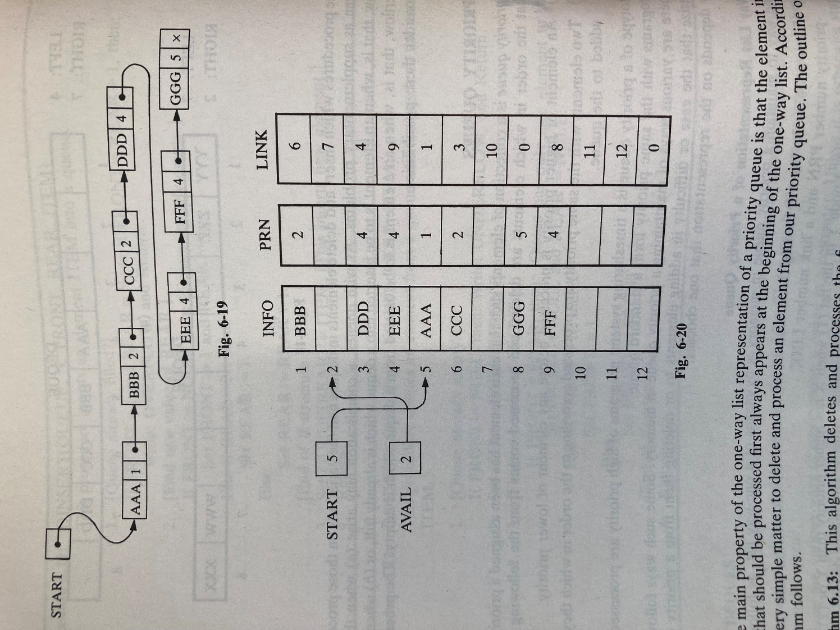
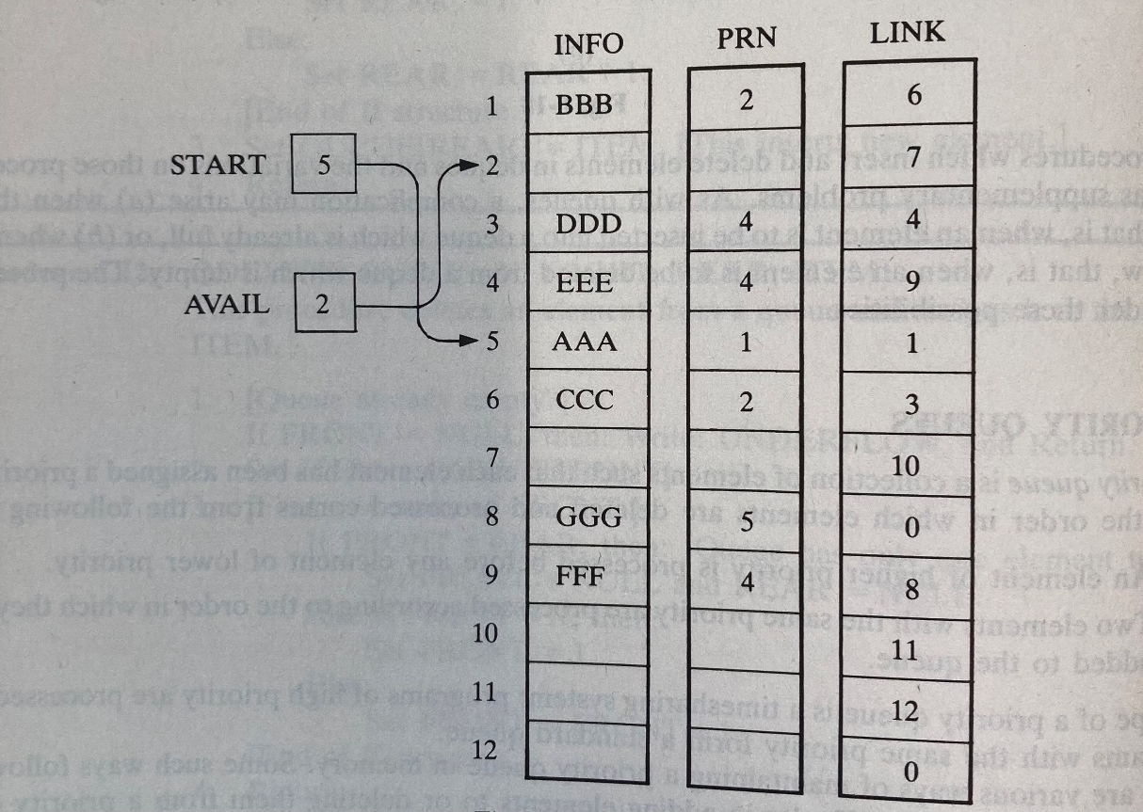
Singly Linked List Representation (2)

Slide 8
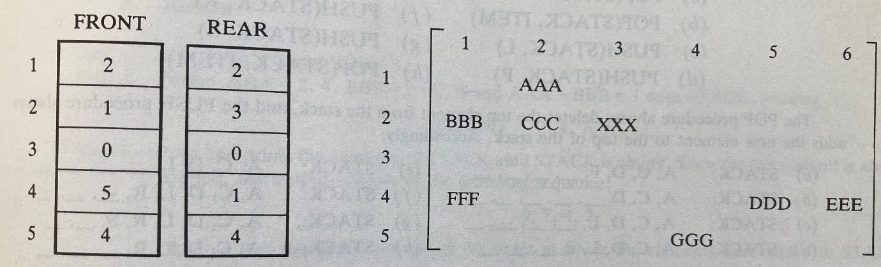
Array Representation
Another way to maintain a priority queue is to use a separate queue for each level of priority (or for each priority number). Each such queue will appear in its own circular array and must have its own pair of pointers, FRONT and REAR. In fact, each queue is allocated the same amount of space, a two-dimensional array QUEUE can be used instead of linear (or parallel arrays), e.g.,

Slide 9
Space-Speed Trade-Off
In the above representations we can see the time-space trade-off when choosing between different data structures for a given problem.
The array representation of a priority queue is more time-efficient than the singly linked list. This is because when adding an element to a singly linked list, one must perform a linear search on the list.
On the other hand, the singly linked list representation of the priority queue may be more space efficient than the array representation. This is because in using the array representation, overflow occurs when the number of elements in any single priority level exceeds the capacity for that level, but in using the singly linked list, overflow occurs only when the total number of elements exceeds the total capacity.
Another alternative is to use a singly linked list for each priority level, e.g.,

Slide 10
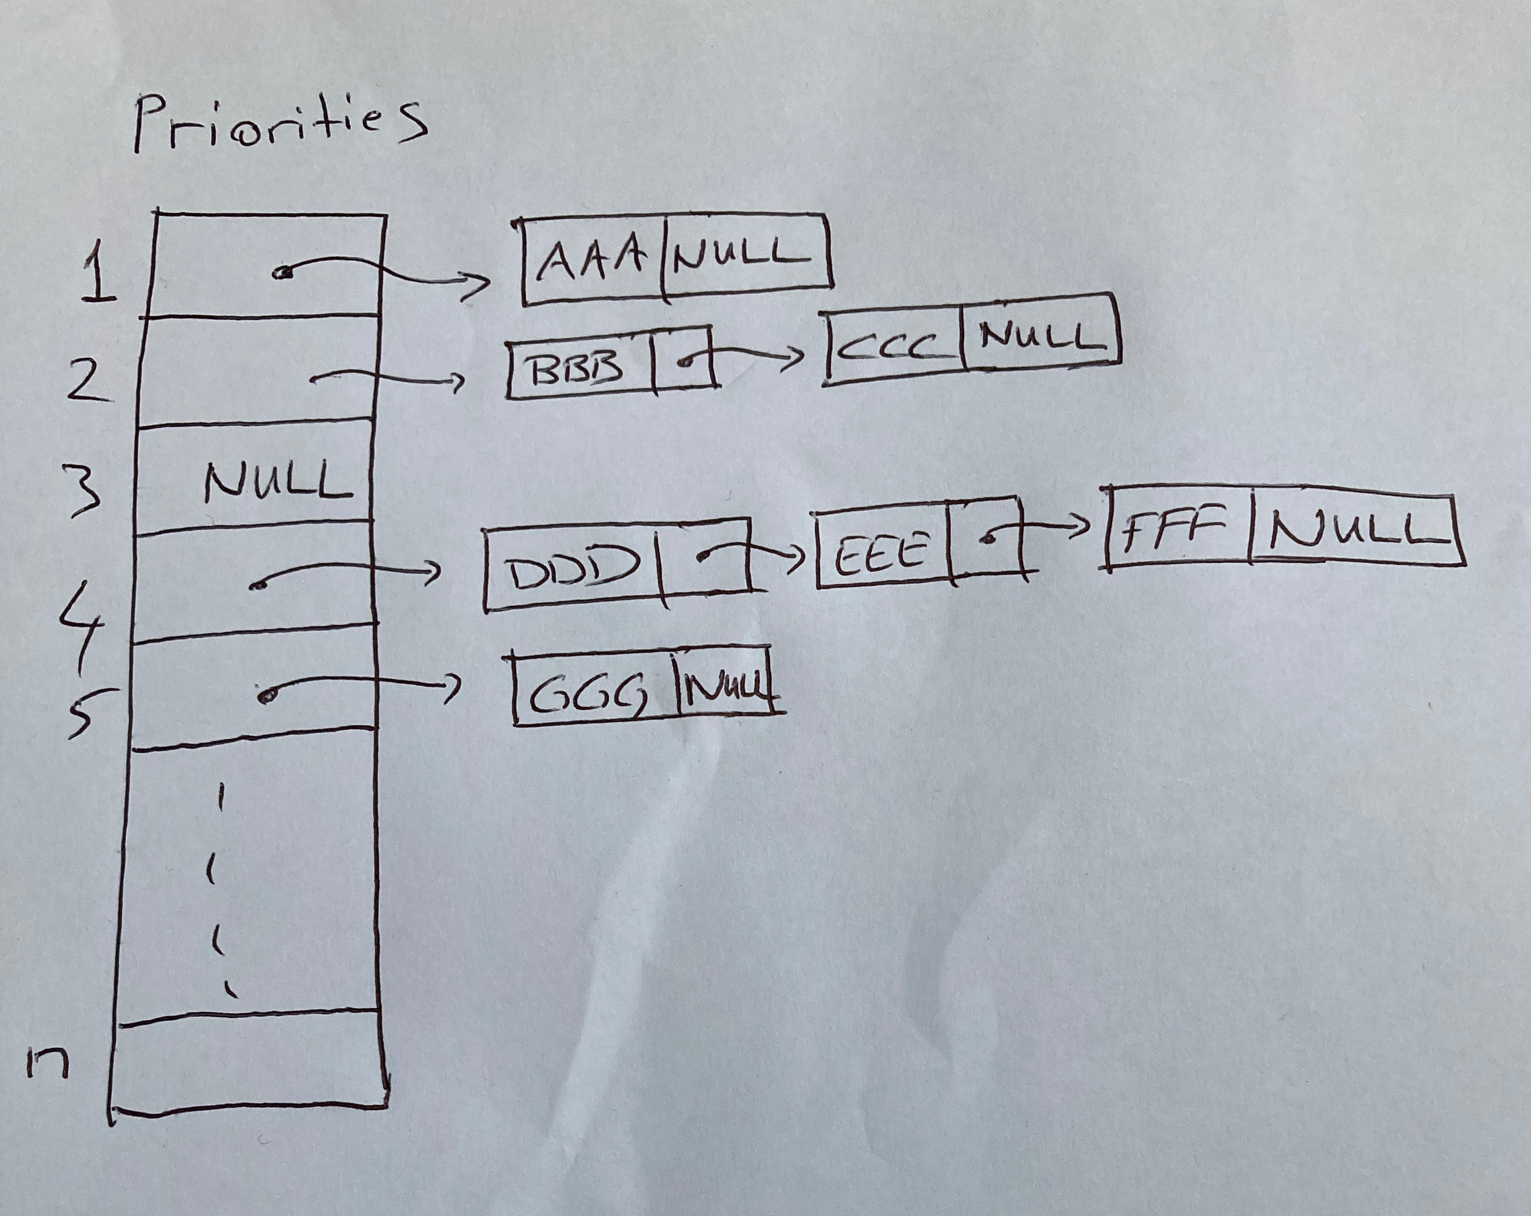
Space-Speed Trade-Off (2)

